Slide 1
BELONGING

Slide 2
GROUPS WE BELONG TO?

Slide 3
GROUPS I BELONG TO

Slide 4
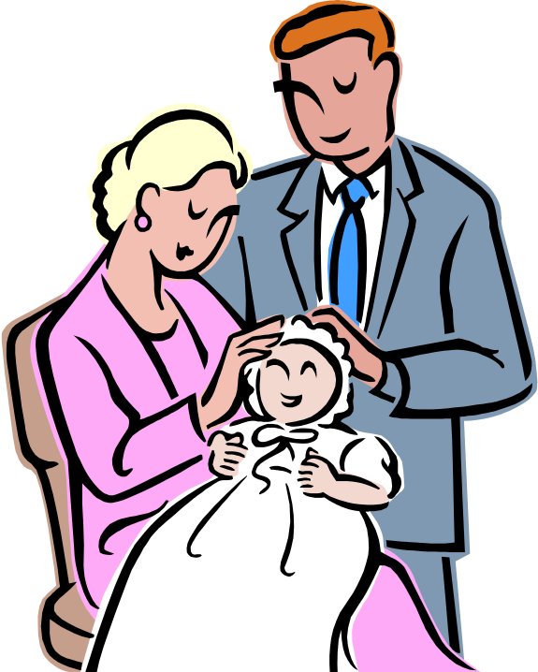
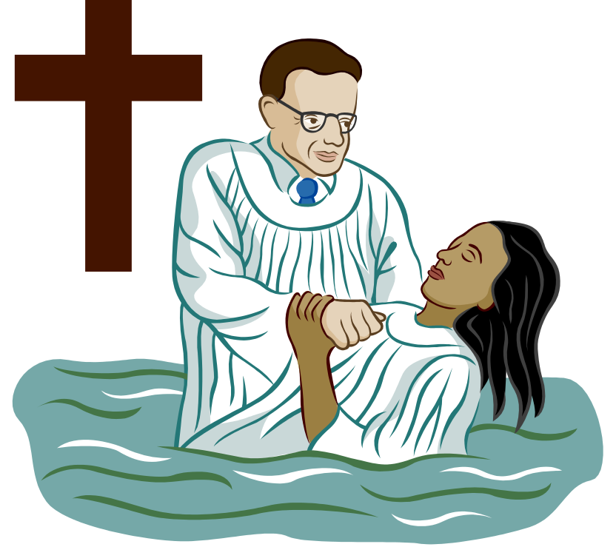
BAPTISM
YouTube - Jesus, John the Baptist & Baptism

Slide 5






SYMBOLS OF BAPTISM

Slide 6
ACTIONS AND WORDS SPOKEN DURING BAPTISM

Slide 7
BASPTISED
Once we are baptised we have completed the first rite.
We can be baptised at any age.
We need a Godfather and a Godmother present during our baptism.
Jesus was baptised by his cousin John, but we get baptised by our Priest.
Baptism is also known as a Christening.

